Slide 1
Contracting to (dis)incentivize? An integrative transaction-cost approach on how contracts govern specific investments
Lo, Zanarone, and Ghosh, SMJ, 2022
BADM549 Youngsir Rha

Slide 2
Research Motive
What drives value creation in collaborative interfirm relationships?
TCE: - Relationship-specific investments drives value creation. - Because investments face contractual hazards, governance structures (contract forms) are needed for safeguarding. - Asset specificity is an exogenous determinant of governance structure
→ How does governance affect the endogenous choice of specific investment?
→ Which governance forms (contracts) encourage/discourage specific investments?
Notes:
An exogenous variable is a variable that is not affected by other variables in the system

Slide 3
Government Forms: Price Formats
Closed price: specifies the component’s price BEFORE the supplier makes the relationship-specific investment
Open price: price can be negotiated after the investment is made

Slide 4
Gap in the Literature
How contractual price terms affect supplier’s incentives to undertake specific investments?
How do the two frictions (haggling and risk of appropriation) jointly shape the direction of such effects?
→ Expands literature on TCE, incomplete contracts, and strategic role of resources of the firm

Slide 5
Modeling Assumptions
There is no ex-post haggling and rent-seeking under a closed price contract.
Only consider price formats as a form of governance mechanisms.
Only consider the case where only the supplier makes a specific investment.
Assume a specific bargaining protocol (Tullock model) where the distribution of surplus is equal between the parties.

Slide 6
Timeline
Stage 1: Contracting Stage - OEM and supplier agree on a governance (price format)
Stage 2: Investment Stage - Supplier chooses a specific investment (bilateral monopoly relationship) - which allows for value creation and appropriation of OEM’s resources
Stage 3: Adaptation Stage - Supplier can further improve the component
Stage 4: Bargaining Stage - In open price format, more exposure to haggling of OEM
Stage 5: Appropriation stage - Supplier takes advantage of OEM’s pre-existing resources

Slide 7
Contratual Hazards (TCE)
Costly haggling
Non-contractible adaptation (supplier’s specific investment)
Risk of appropriation of firm-specific resources that perexist before the relationship
→ How does the specific investment choice of the supplier jointly affect these hazards?
OEM’s haggling and supplier’s appropriation of preexisting resources
→ What is the optimal choice of contract form when adaptation is important?
Haggling cost held constant, open price format increases specific investment. (But when adaptation is not important, it will decrease specific investment)
→ What if there is risk of appropriation?
Open contracts increase supplier’s investment, while closed contracts decrease supplier’s investment. Closed contract is the optimal choice.
Notes:
joint effect has not been studied previously. this is where the novel findings of this paper come from.
Once the supplier invests, he faces unforeseen opportunities, he takes the non contractible adaptation action. Although there is value creating benefit to it, there are downsides like OEM’s opportunistic haggling over the price and the supplier’s appropriation of preexisting resources from OEM.

Slide 8
Closed Price Format
Open Price Format
Stage 1: Contracting Stage
price is specified. | price is not specified.
Stage 2: Investment Stage
Supplier chooses a specific investment to appropriate of OEM’s resources | Supplier chooses a specific investment to earn the expected payoff= appropriation+half of quasi-rents-haggling cost
Stage 3: Adaptation Stage
supplier has no incentive to adapt because they will only bear the cost | Supplier has incentive to adapt because they will share the value added via adaptation
Stage 4: Bargaining Stage
no haggling of OEM | Price bargain. Haggling loss for both parties
Stage 5: Appropriation stage
Supplier takes advantage of OEM’s pre-existing resources | Supplier takes advantage of OEM’s pre-existing resources

Slide 9
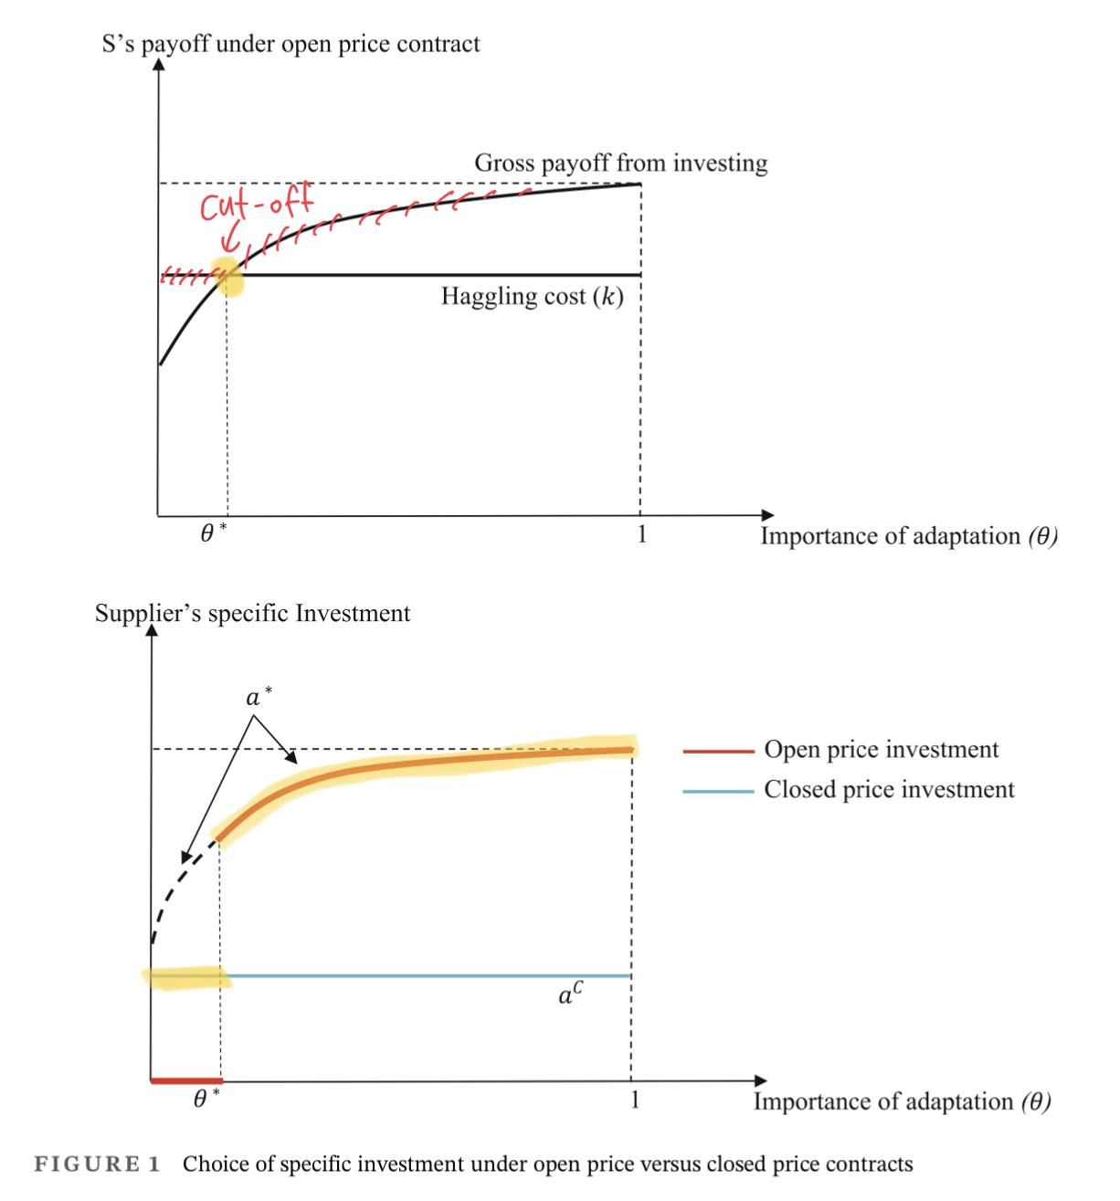
Proposition 1
Proposition 2
There is a critical cutoff, such that under a closed price, supplier’s specific investment is higher than under an open price contract when adaptation is unimportant, and lower when adaptation is important.
Under a closed price, supplier’s value-added is higher than under an open price when adaptation is unimportant, and lower when adaptation is important.

Slide 10
Optimal Price format: Proposition 3
Which price format maximizes total value creation of the two parties?
Depends on the combinations of contracting frictions.
When the pre-existing resources is low (appropriation is not important), supplier under-invests due to haggling and appropriation frictions. Therefore, the optimal format is the one that incentivizes supplier’s investment. → Closed price format when adaptation is unimportant → Open price format when adaptation is important
When pre-existing resources is high, suppliers over-invest. So the optimal price format is the one that disincentivizes supplier’s investment. → Closed price format when adaptation is important → Open price format when adaptation is unimportant.

Slide 11
Empirical Design
Survey data on 155 procurement contracts for components between OEMs and supplier in the U.S.
Importance of adaptation: measured by interface complexity. Higher the complexity, higher the need to adapt ex-post.
7-point Likert scale to measure supplier’s specific investment intensity and the value add to OEM’s product.
Control variables: - for OEM’s bargaining power: the total number of potential suppliers, OEM’s relative size, supplier irreplaceability, and component importance - for factors that might affect the choice of price formats: contract enforceability, technological uncertainty, tenure, norm of long-term orientation, norm of flexibility, and controls for alternative governance mechanisms.
Tested for common method variance issue
Uses instrument variables to account for endogeneity of price format (contract enforeability)

Slide 12
Empirical Findings
1. Closed price format:
when adaptation IS important: disincentivizes investment
when adaptation is NOT important: incentivizes investment
2. Effect of of adaptation on contract choice (1) is moderated by risk of resource appropriation.
when adaptation IS important: likelihood of choosing a closed price format is increased when the OEM’s pre-existing resources have high value

Slide 13
Implications
Which contract form increase or decrease supplier’s specific investment depends on the relative importance of haggling and adaptation frictions.
When appropriation risk is included, the conventional governance role of contracts can be reversed. (They can disincentivize specific investment under high importance in adaptation)
Different buyers (OEMs) with different pre-existing resources will seek different governance forms for their relationship with the same supplier.
Paves way for “strategic theory of the firm”.

Slide 14
Thank you

